Slide 1

Your trip to
Château de la Baudonnière

Slide 2
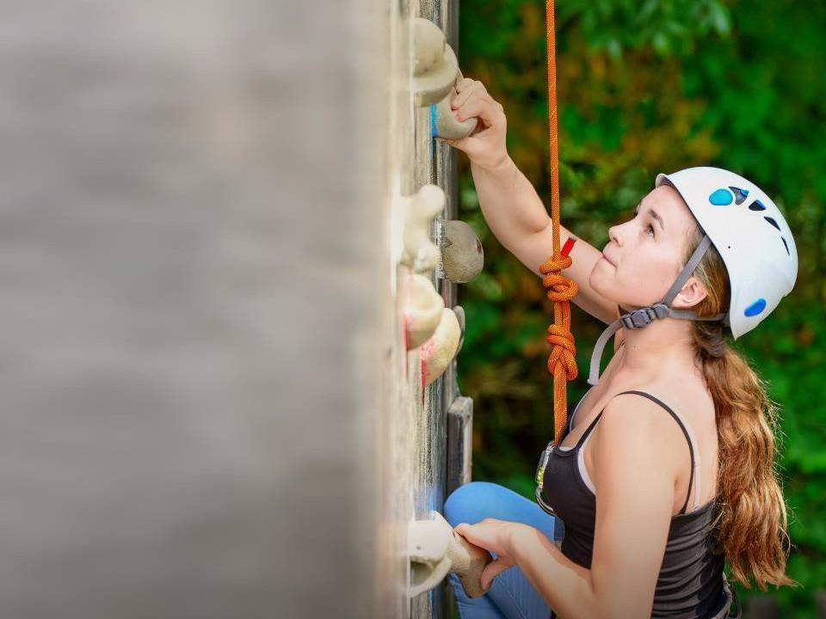
We help students reach new heights
Château de la Baudonnière specialises in language immersion educational school trips where students can learn, thrive and achieve their potential outside the classroom.
We believe that every school trip should provide students with new experiences, learning activities and exposure to local culture with genuine educational benefit.

Slide 3




You’re in
safe hands
La Grand’Ferme is authorised to accommodate school groups by the French Ministry of Youth and Sport.
Our other Normandy centre, Château de la Baudonnière, is also accredited by the French Ministry of Education because we run language programmes for school groups from France.
Your group’s safety is our priority
All our animateurs hold the appropriate qualifications for the activities they lead, as well as first aid and lifeguarding qualifications.
ABTA member
ATOL and ABTOT financial protected
Audited safety management system
All accommodation audited
More about accreditation.

Slide 4
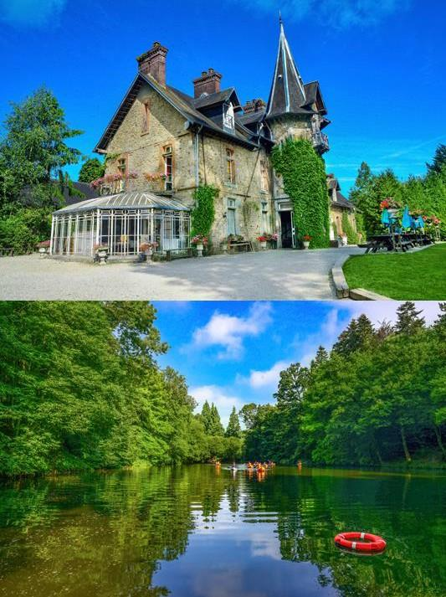
Welcome to the Château!
Everything at the Château will be conducted in French, from the activities to mealtimes, and there’s always an emphasis on trying your best and having fun!
With so many fantastic facilities on site, you’ll enjoy a jam-packed programme of language-based physical activities
Take a tour of the Château grounds.

Slide 5
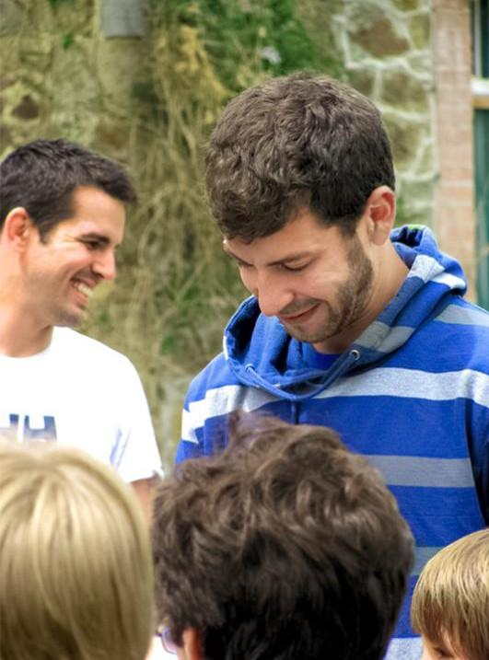
Meet your animateur
Upon your arrival you’ll meet your
animateur!
Our specially trained French native animateurs will be speaking with and encouraging interactive responses from you throughout your stay to challenge you and improve your language skills

Slide 6
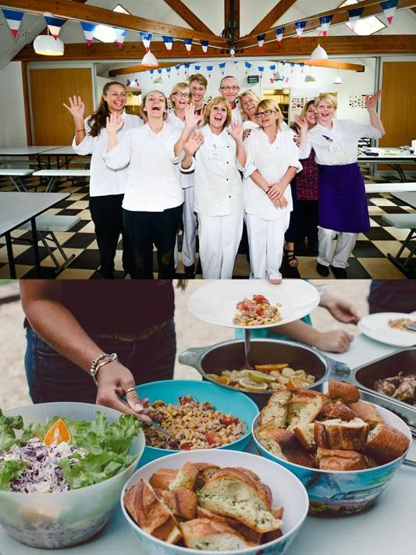
Food
& dining
Your stay at the Château is full board, which means you'll enjoy a seasonal menu of home-cooked meals tailored to students' tastes while maintaining a French flare
Our skilled chefs are experienced in catering to any special dietary requirements your group may have

Slide 7
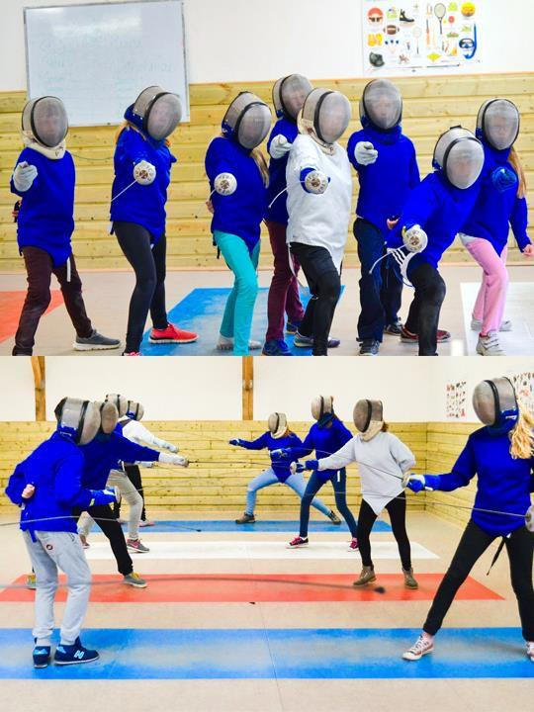
Fencing
Fencing takes place on-site and is an excellent opportunity for students of all ages to learn French in a safe and fun environment, as well as learn about the safety and the equipment.
This activity also encourages the students to practise new phrases in French as well as enjoying the fencing itself.

Slide 8
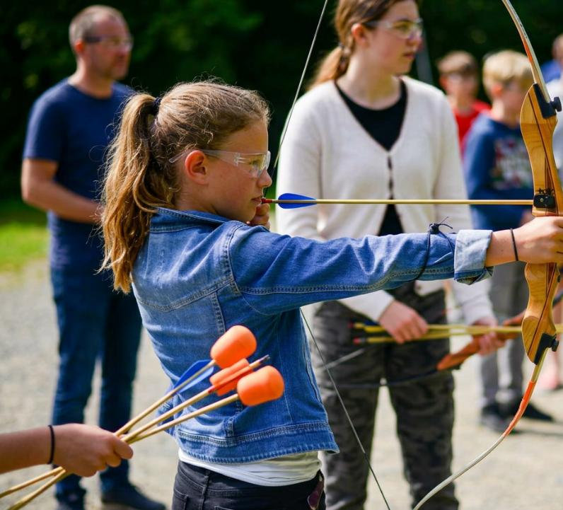
Robin Hood
Students get the chance to be a Robin Hood. After an explanation of the equipment and some basic skills training, students shoot foam tipped arrows through holes in targets, an excellent opportunity to practise numbers and directions in the target language.

Slide 9
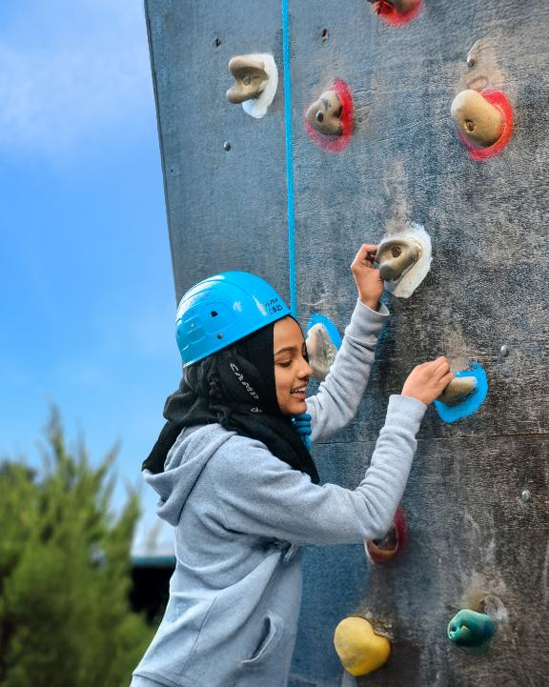
Climbing wall
Climbing sessions take place at the Centre's own climbing wall which is suitable for students of any age. After issuing equipment and explaining the safety procedures, the students will climb various paths on the wall.
They will use commands in French to each other and will learn French words for movements and parts of the body.

Slide 10
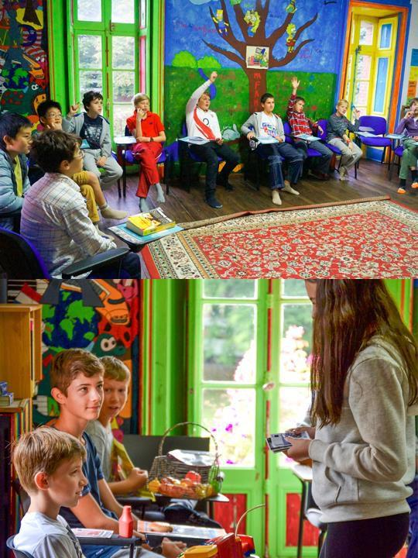
French lessons
Our animateurs will run all the activities, mealtimes and evening entertainment in French, encouraging your students to use the language at every opportunity and helping to improve their confidence and language skills.

Slide 11
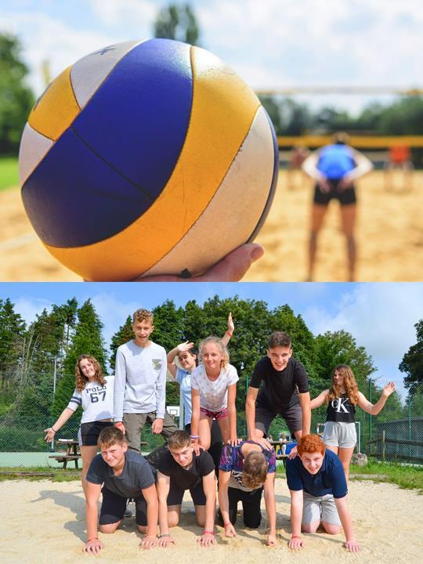
Volleyball
Your students will be split into teams to play volleyball on the Centre's own court. The game is a great way to practice numbers, instructions and directions in the target language.

Slide 12
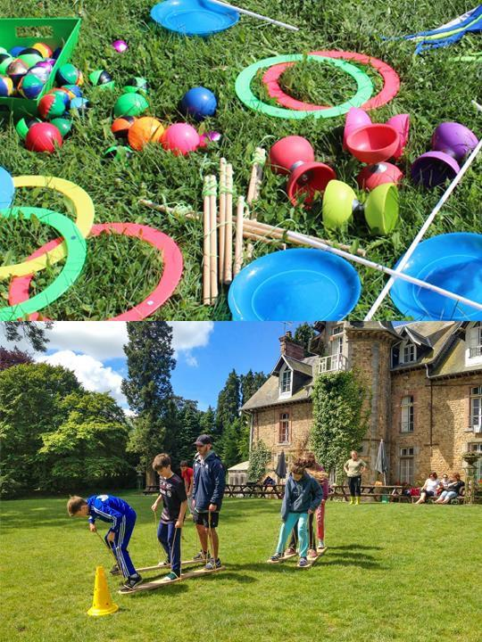
Circus skills
Enables pupils to discover the art of circus on an artistic as well as technical level. Students are introduced to juggling, diabolo and other circus equipment in a fun and educational manner. The French spoken during this activity is very varied and is based on using the names of the equipment (stick, balls, diabolo...), action verbs (to walk, to move...), directions (left, right, up, down...), colours (orange, red, green...), numbers (one, two, three...).

Slide 13
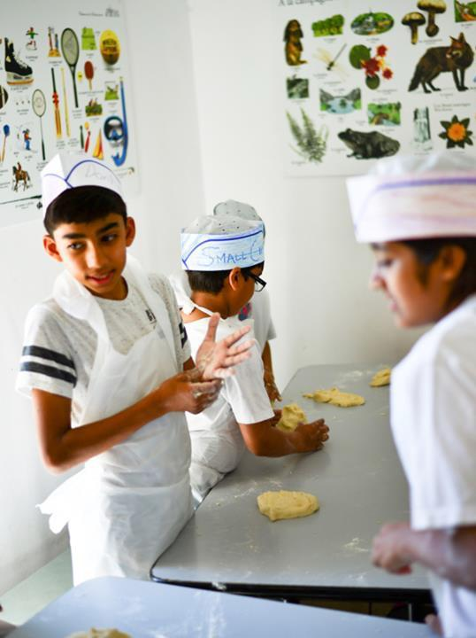
Bread making
Don your chef’s hat and unleash your
inner baker.
During this activity, you’ll learn vocabulary relating to weights and measurements as you follow the recipe, guided by your animateur. You’ll also enjoy a French singalong!
Try your best to follow the recipe because you’ll be enjoying the fruits of your labour later on.

Slide 14
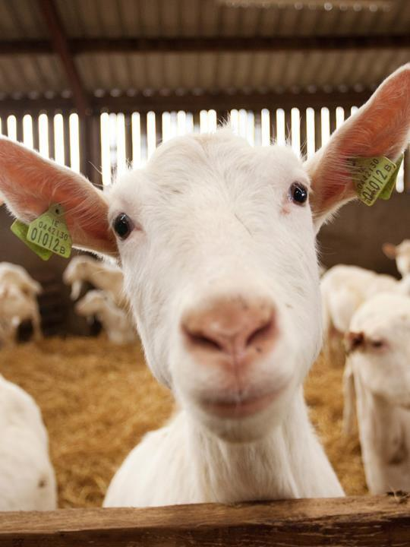
Goat cheese farm
An interactive visit of a local working goat farm and cheese producer (or similar alternative) Includes the all important tasting of the famous Normandy produce

Slide 15
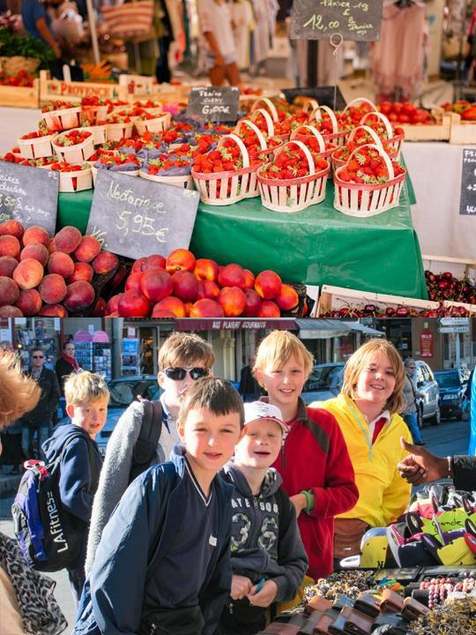
Market mission
Visit a local market with your animateur
Teams of students will be given money to buy ingredients for a packed lunch and you will also have some general shopping time
Return to your accommodation where your animateur will organise a competition for the best lunch

Slide 16

Mont Saint- Michel
Mont Saint-Michel and its bay are part of the UNESCO list of World Heritage Sites and more than 3 million people visit it each year. Visit the Abbey, Monastery, Great Halls and shops and village housing
Outside the walls, there are fishermen and farmer houses

Slide 17
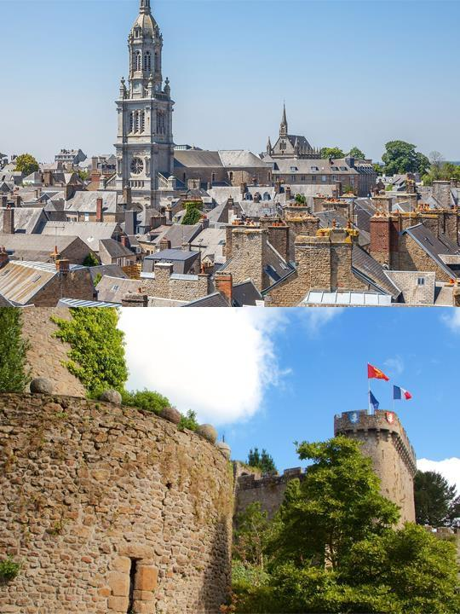
Avranches town trail
Your animateur organises this activity with our tailor made Town Trail requiring the students to read, understand and speak French

Slide 18
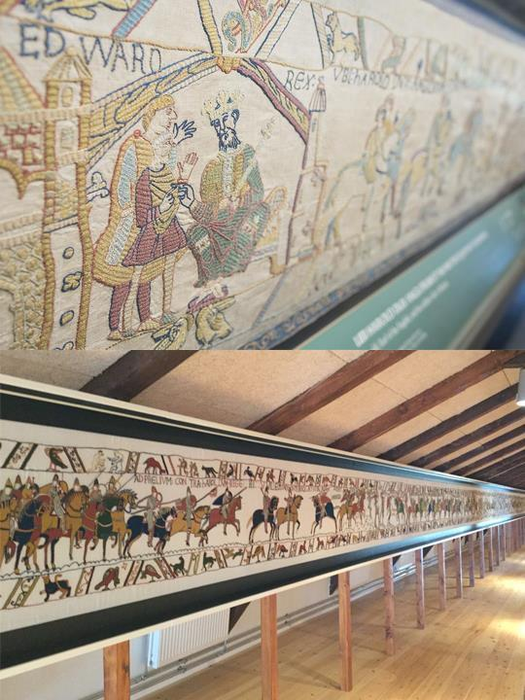
Bayeux Tapestry
The Bayeux Tapestry is a hand- crafted embroidery measuring 70 metres long, made in the 11th century and is listed by UNESCO as a “memory of the world”

Slide 19

Click here for more information about the trip!
Find us on

