Slide 1
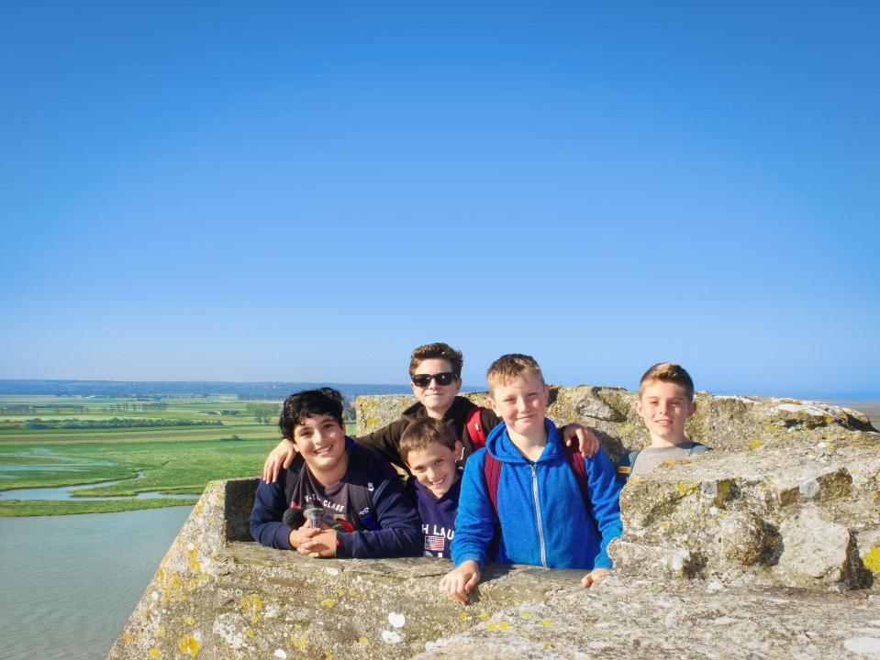
Your trip to La Grand’Ferme
School Name
DD–DD MM YYYY

Slide 2
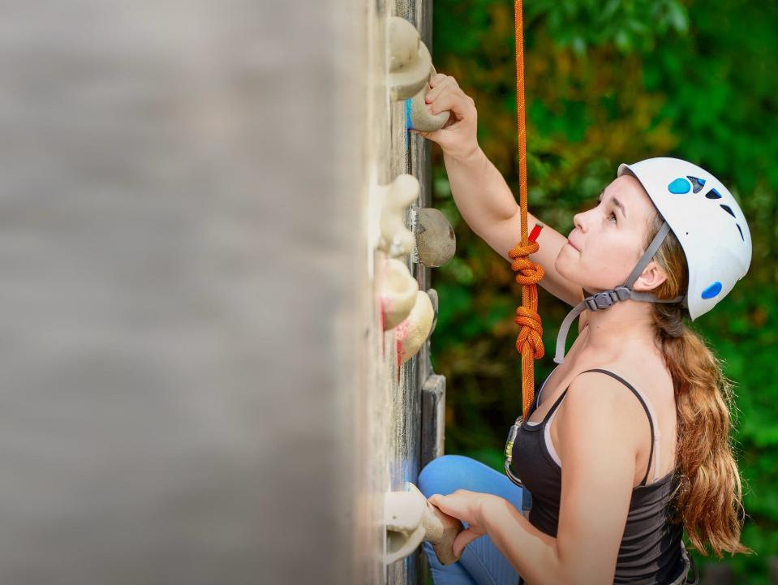
We help students reach new heights
Voyager School Travel specialises in educational school trips where students can learn, thrive and achieve their potential outside the classroom.
We believe that every school trip should provide students with new experiences, learning activities and exposure to local culture with genuine educational benefit.
Over 35,000 students travel with us each year

Slide 3




You’re in
safe hands
La Grand’Ferme is authorised to accommodate school groups by the French Ministry of Youth and Sport.
Our other Normandy centre, Château de la Baudonnière, is also accredited by the French Ministry of Education because we run language programmes for school groups from France.
Your group’s safety is our priority
All our animateurs hold the appropriate qualifications for the activities they lead, as well as first aid and lifeguarding qualifications.
ABTA member
ATOL and ABTOT financial protected
Audited safety management system
All accommodation audited
More about accreditation.

Slide 4
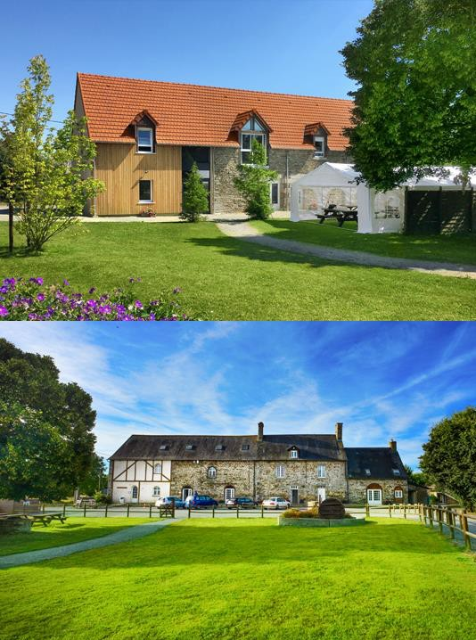
Welcome to
La Grand’Ferme!
Everything at La Grand’Ferme will be conducted in French, from the activities to mealtimes, and there’s always an emphasis on trying your best and having fun!
With so many exciting attractions nearby in beautiful Normandy, you’ll enjoy a jam-packed programme of day trips and visits to attractions, plus some on-site activities!

Slide 5
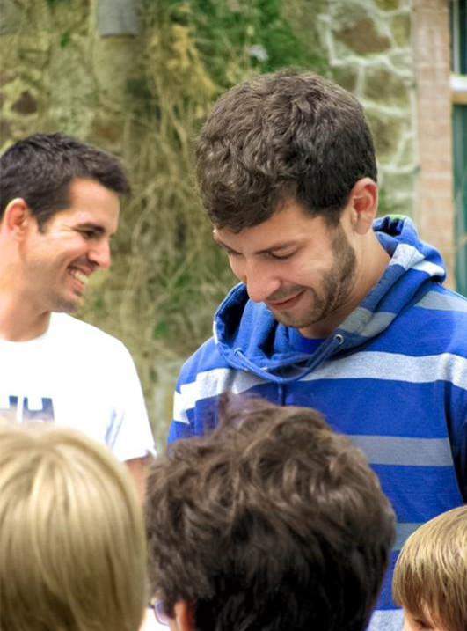
Meet your animateur
Upon your arrival you’ll meet your animateur!
Our specially trained French native animateurs will be speaking with and encouraging interactive responses from you throughout your stay to challenge you and improve your language skills

Slide 6
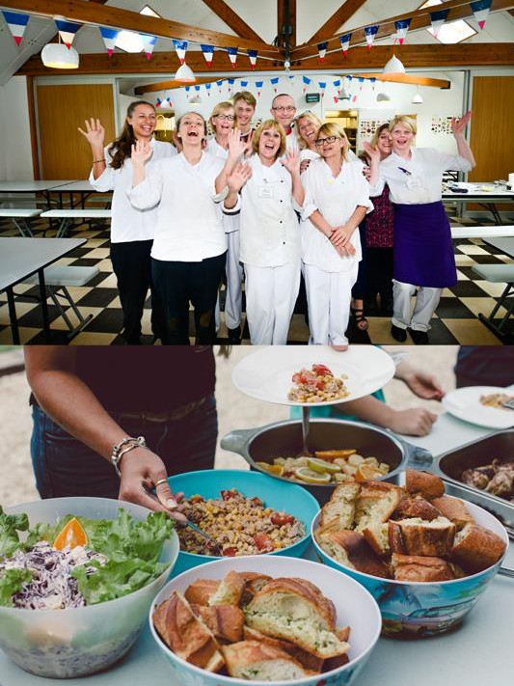
Food
& dining
Your stay at La Grand’Ferme is full board, which means you'll enjoy a seasonal menu of home-cooked meals tailored to students' tastes while maintaining a French flare
Our skilled chefs are experienced in catering to any special dietary requirements your group may have

Slide 7
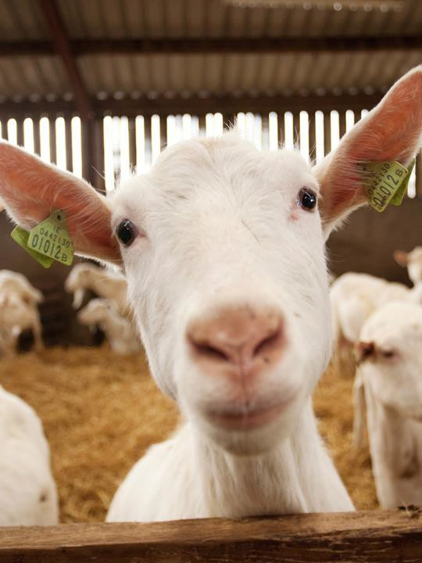
Goat cheese farm
An interactive visit of a local working goat farm and cheese producer (or similar alternative)
Includes the all important tasting of
the famous Normandy produce

Slide 8
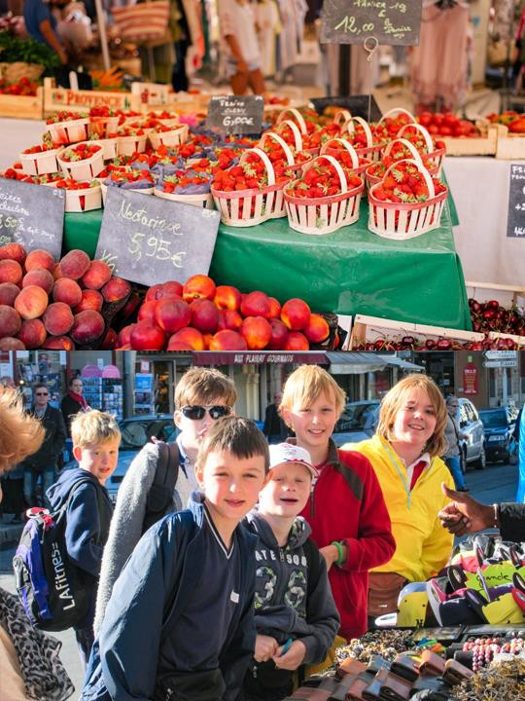
Market mission
Visit a local market with your animateur
Teams of students will be given money to buy ingredients for a packed lunch and you will also have some general shopping time
Return to your accommodation where your animateur will organise a competition for the best lunch

Slide 9

Mont Saint- Michel
Mont Saint-Michel and its bay are part of the UNESCO list of World Heritage Sites and more than 3 million people visit it each year. Visit the Abbey, Monastery, Great Halls and shops and village housing
Outside the walls, there are fishermen and farmer houses

Slide 10
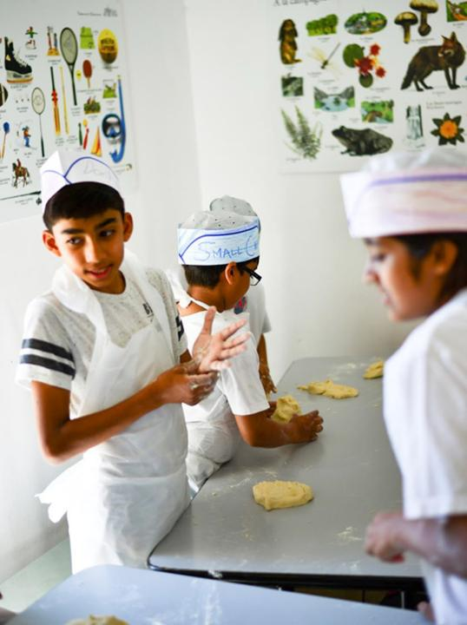
Bread making
Don your chef’s hat and unleash your inner baker.
During this activity you’ll learn vocabulary relating to weights and measurements as you follow the recipe. You’ll also enjoy a French singalong!
Try your best to follow the recipe because you’ll be enjoying the fruits of your labour later on.

Slide 11
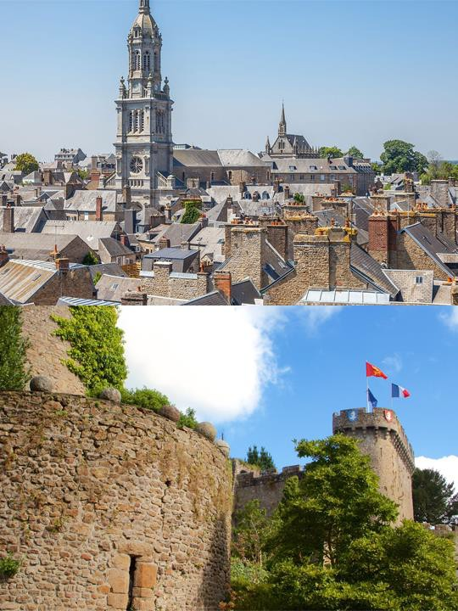
Avranches town trail
Your animateur organises this activity with our tailor made Town Trail requiring the students to read, understand and speak French

Slide 12

Find us on
Click here for more information about the trip!

